Slide 1

Building Your First React App

Slide 2
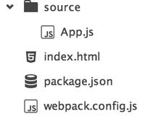
React Development Workflow

Slide 3
Creating Your First Component
import React from 'react'; class Hello extends React.Component { render() { return ( <h1>Hello</h1> ); } } React.render(<Hello />, document.getElementById("root"));

Slide 4
Dynamic Values
import React, { Component } from 'react'; class Hello extends Component { render() { var place = "World"; return ( <h1>Hello {place}</h1> ); } } React.render(<Hello />, document.getElementById("root"));

